Slide 1
Library Management
System
Group 8

Slide 2
Abstract
Library management system is a project which aims in developing a computerized system to maintain all the daily work of library.
Understanding the requirements of the library in our college,We will design a software adding various unique and essential features, which will ease the work of library like issuing and returning of books,collection of penalties ,budget analysis, searching of a book for a student,notifying a student with the deadlines and so on.
Overall this project of ours is being developed to help the students as well as staff of library to maintain the library in the best way possible and also reduce the human efforts.

Slide 3
Motivation
We met the director of libraries,Ahmedabad University, Mr G.K. Manjunath to understand the working and requirements of a library in our university.There is an existing software of library management system in the university, however there are various bugs and various additional requirements, which We would like to work upon through this project.

Slide 4
Project Aims and Objectives
To allow user to reserve a book online.
To convenience the user to search and borrow book online.
To provide an option to the members to prioritize the book when it is not available and hence notify when the book gets available.
To notify the students about the deadlines via email.
To calculate the penalties.
To add and update book information for a librarian easier.
To design a user friendly graphical interface that suits a user.
To make system more organized, time saving and systematic.

Slide 5
Stakeholders
Students
Faculty
Director of Library
Admin
Head Librarian
Library Staff
Dean of the University
Management Team
Design / Programming Team

Slide 6
System Requirements
Functional Requirements
Non Functional Requirements

Slide 7
Functional Requirements
User login
The users of the system are students and faculties who are the members of library, and librarian.
Requirements:
User id is provided when the users register
The system must only allow user with valid id and password to enter the system
The system performs authorization process which decides what user level can access to
The user must be able to logout after they finished using system

Slide 8
Functional Requirements
Register a new book in library
This feature will help to allow a librarian to add new books to the library and also to update the number of copies and delete it.
Requirements:
System must be able to verify information
System must be able to enter number of copies into table.
System must be able to not allow two books having same book id.

Slide 9
Functional Requirements
Search a book in library
By incorporating this feature we can search book based on book id-ISBN no, book name, publication or by author name.
Requirements:
System must be able to search the database based on select search type.
System must be able to filter book based on keyword entered.
System must be able to show the filtered book in table view

Slide 10
Functional Requirements
Issue and return books
This feature allows to issue and return books and also view reports of book issued.
Requirements:
System must be able to enter issue information in database.
System must be able to update number of books.
System must be able to search if book is available or not before issuing books
System should be able to enter issue and return date information

Slide 11
Functional Requirements
Email notification
This feature allows to notify the members that the book is issued or returned, when the deadline of returning a book is about to reach,and when a student has kept a book in the waiting state and it gets available.
Requirements:
System must be able to directly send an email using the email id provided in the registered members table.
In order to send an email, proper information like when did the book got issued, what is the penalty and various others must be fetched very carefully from the database.

Slide 12
Functional Requirements
Penalty calculation
The penalty calculation is an important aspect of a LMS and the penalties constraints will differ as per the types of members and has to be taken care of.
Requirements:
System must be able to distinguish the member whether he is student or faculty and the calculation must be as per that way.
The penalty constraint provided as of now is 5 Rs a day for students and no penalty for faculties.

Slide 13
Functional Requirements
Additional Requirements, as addressed by Mr G.K. Manjunath to improvise the current system:
In case a book is in high demand,the time for returning must be reduced so that the others could get the advantage.
In case of waiting, an email should be automatically sent to the user that the book is now available.
While searching a book,the input to add while searching a book could not be just limited to English, but an individual should also be able to search a book in Hindi or Gujarati.
The system should be able to even order the books from the outside sources.
Keep the track of budget provided to the library by Ahmedabad University.
If We have a new branch in the upcoming years,it must be able to interoperate to both the branches and the data must be well taken care of.

Slide 14
Non functional Requirements
A. Efficiency requirement
When a library management system will be implemented both librarian and user will easily access library, as searching and book transaction will become faster.
B. Reliability requirement
The system should accurately performs userregistration ,user validation, book transactions and search,email notifications without any error.
Notes:
n systems engineering and requirements engineering, a non-functional requirement (NFR) is a requirement that specifies criteria that can be used to judge the operation of a system, rather than specific behaviors.

Slide 15
Non functional Requirements
C. Usability requirement
The system is designed for a user friendly environment so that student and staff of library can perform the various tasks easily and in an effective and user friendly way.
D. Implementation requirement
The Library Management system is expected to be implemented under proper platform discussed by the client without any errors and must be compatible to various systems.
Notes:
n systems engineering and requirements engineering, a non-functional requirement (NFR) is a requirement that specifies criteria that can be used to judge the operation of a system, rather than specific behaviors.

Slide 16
Assumptions
The search of book and member is kept based on book and member id because whenever he/she wants to issue an book, the librarian will see the member id issued from the icard for each and every member,Also there is a sticker of bookid written on each and every book of library so he needs to see the id and insert it.
In case of multiple students waiting for the books,the student with first cum first serve gets the chance to issue it.

Slide 17
Software requirements
Operating System: Windows 7 and onwards- as it is stable, more user friendly and support various features.
Database: MySQL is used as database as it easy to maintain and retrieve records by simple queries which are in English language which are easy to understand and easy to write.
Development tools and Programming language: we have used JAVA as the programming language as the object oriented approach is more suitable for the project.

Slide 18
Hardware requirements
Intel core i5 2nd generation and onwards, is used as a processor because it is fast than other processors an provide reliable and stable and we can run our machine for longtime.By using this processor we can keep on developing our project without any worries.
A minimum of 1GB RAM is used as it will provide fast reading and writing capabilities and will in turn support in faster processing

Slide 19
Requirements Traceability Matrix:-
Sr. No | Req. ID | Req. Description | Test Case ID | Test Case Description | Test Result | Defects?
1 | Req01 | Login to LMS | TC01 | Invalid Username,Valid Password | Passed | None
2 | Req01 | Login to LMS | TC02 | Valid Username, Invalid Password | Passed | None
3 | Req01 | Login to LMS | TC03 | Valid Username,Valid Password | Passed | None

Slide 20
All Requirements
Analysis Document
1.Use Case 2. DFD 3.Activity Diagram
4. Sequence Diagram 5.State Diagram

Slide 21
Use Case
Diagram:-

Slide 22
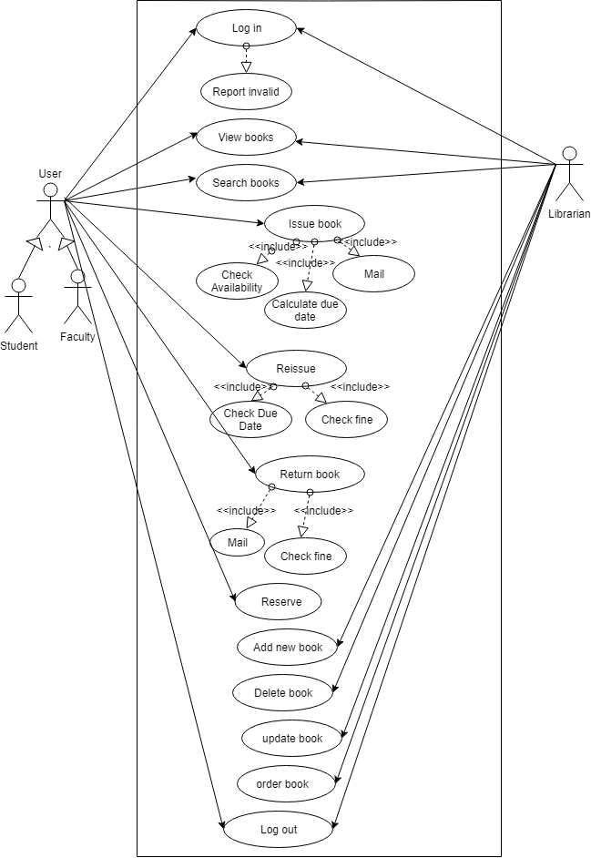

Slide 23
Data Flow
Diagram:-

Slide 24
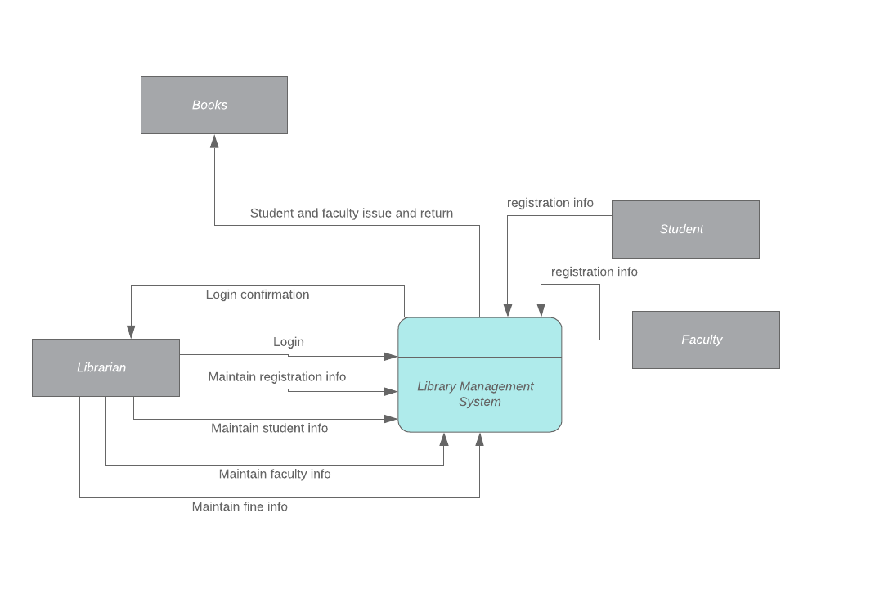
Context Diagram:-

Slide 25
Level 1
Diagram:-

Slide 26
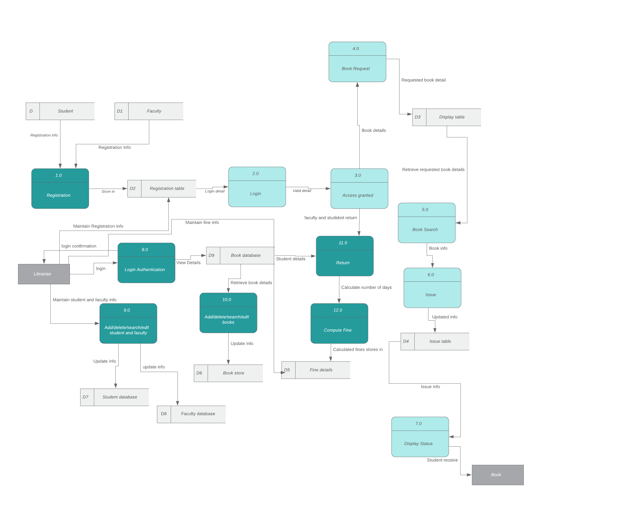

Slide 27
Activity
Diagram:-

Slide 28
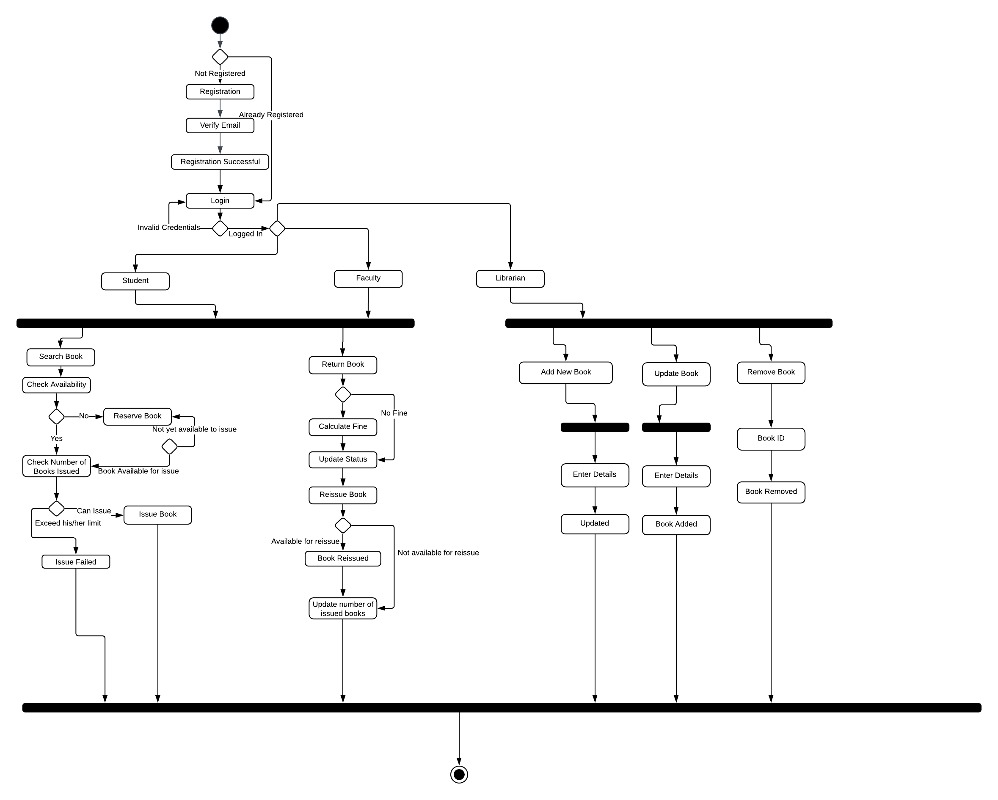

Slide 29
Sequence
Diagram:-

Slide 30
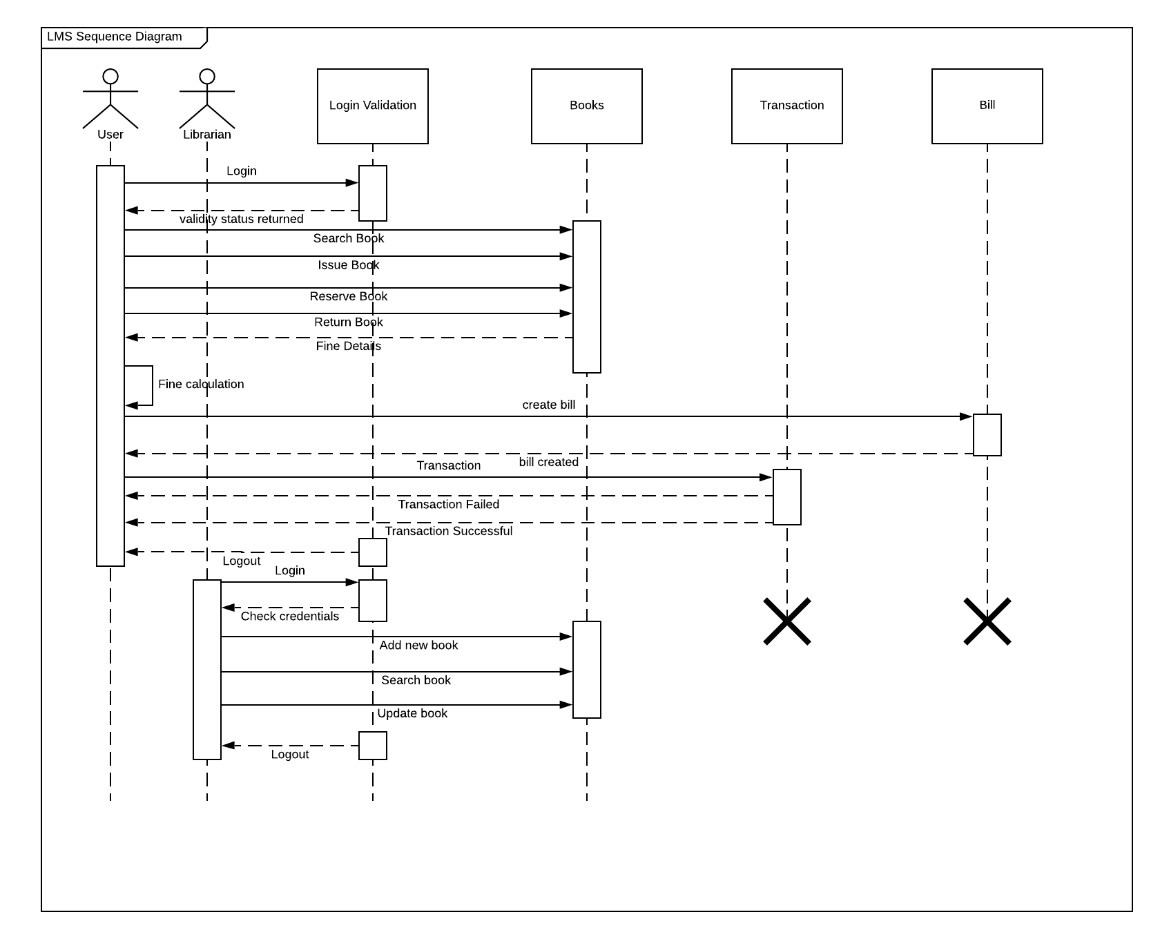

Slide 31
State
Diagram:-

Slide 32
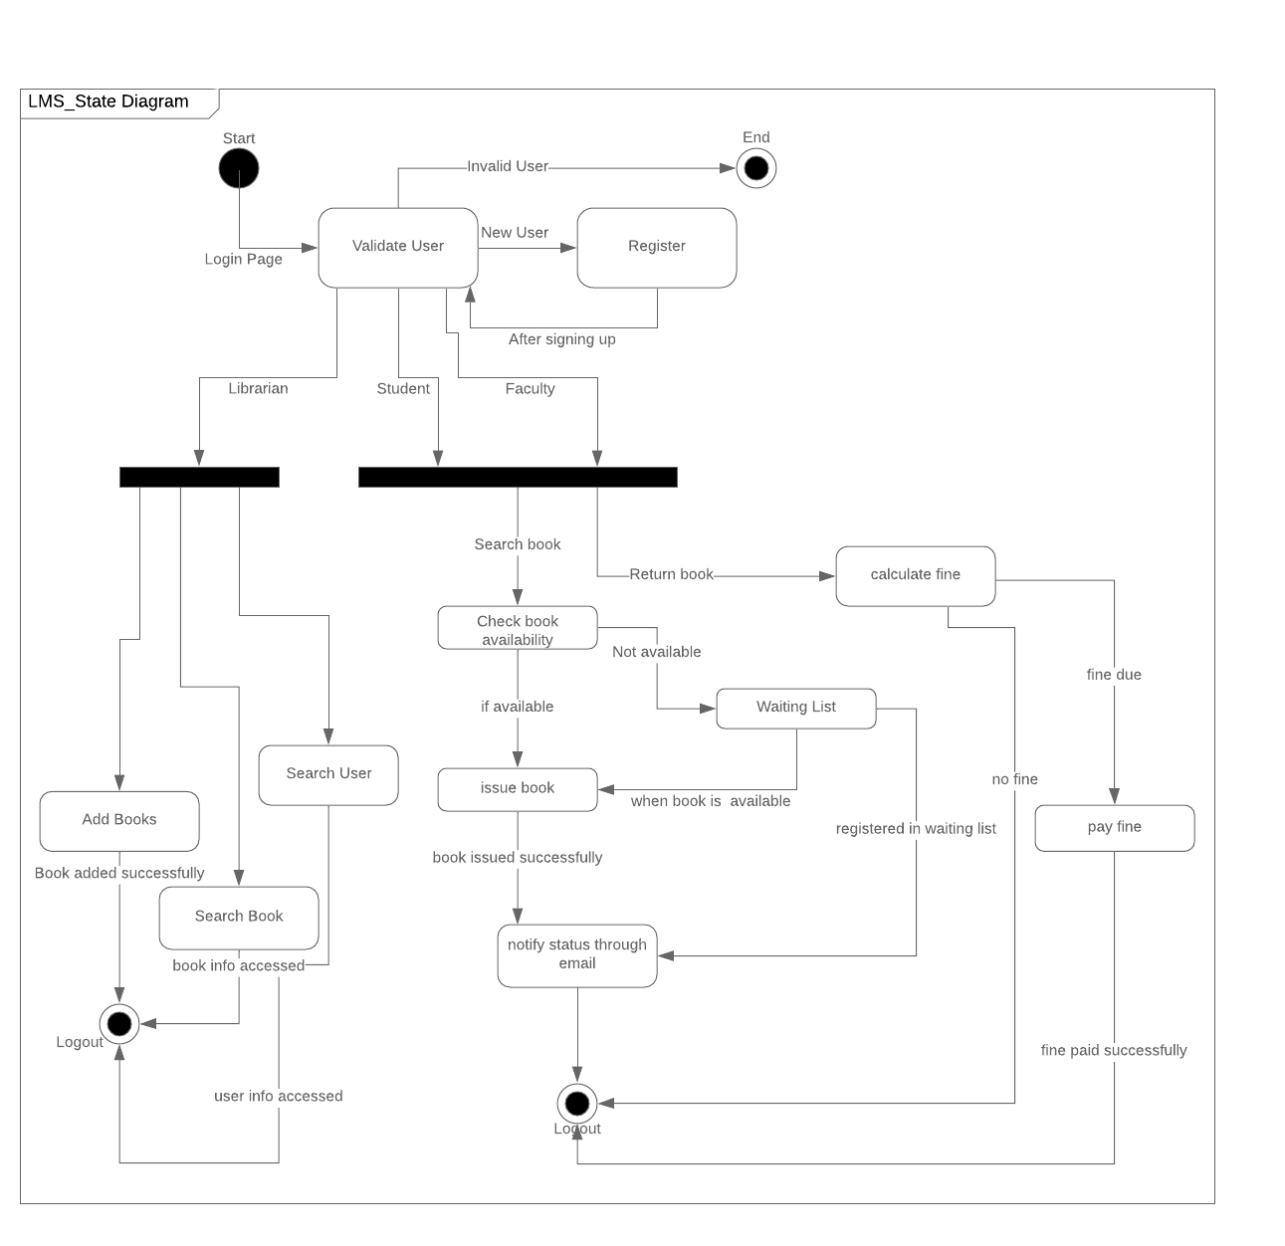

Slide 33
Design Documents
ER Diagram
User Interface Design

Slide 34
Entity Relationship(ER)
Diagram:-

Slide 35
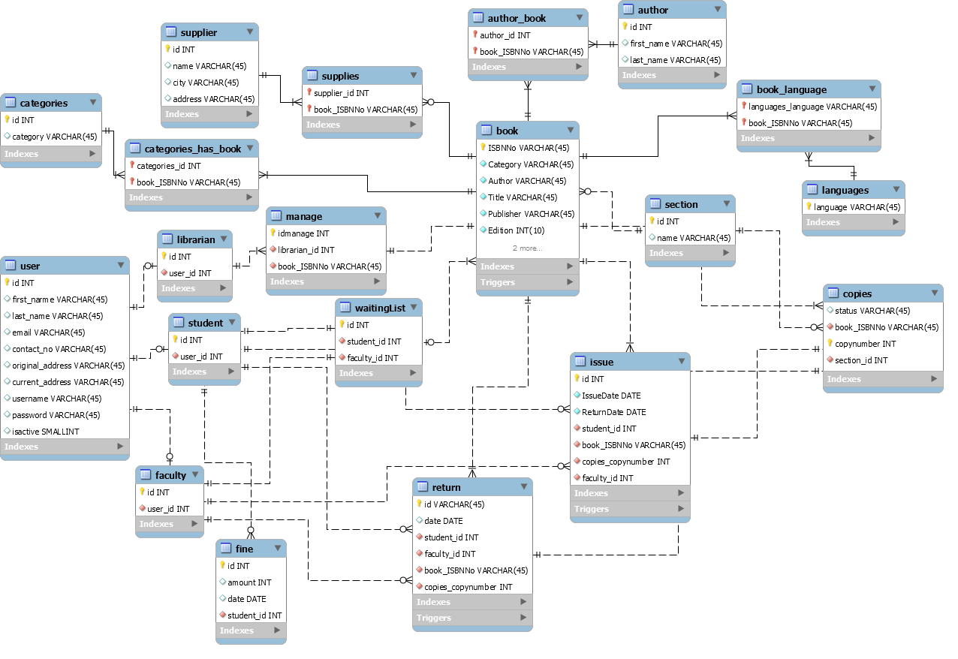
ER Diagram:-

Slide 36
User
Interface
Design

Slide 37

Login Screen

Slide 38
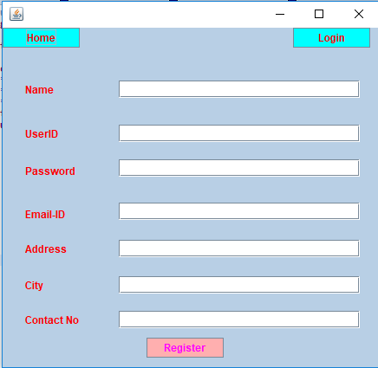
Registration screen

Slide 39
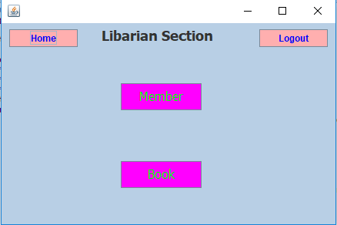
Librarian Home Screen:-

Slide 40
Thank You

